Slide 1
Project Proposal & Paper Presentation – Report
By Moeller and Reichmann (2021)
Matthias Fahrngruber
Filip Lukijanovic
Peter Prlleshi
January 24, 2023

Slide 2
What have we done since last time?
Find all FED statements between 01/2013 and December 12/2023
Find the SPX values between January 01/2013 and December 12/2023
Match the SPX values for each statement day → 77 datapoints
Evaluate Tone, Unc, Con of every statement
Compute abnormal returns and check them with the according SPX evaluation

Slide 3
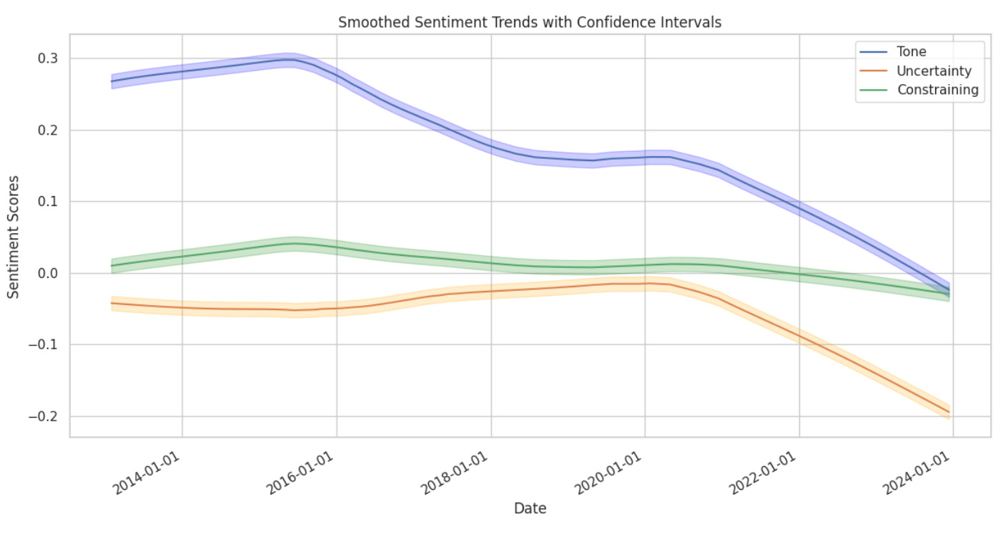
The narrative over the last ten years
higher means more – graph is smoothed

Slide 4

All the Sentiments…
Methodology of Sentiment Analysis
Sentiment is measured across 3 Dimensions
Tone
Constraining Language
Uncertain Language
Simple approach to sentiment with a financial twist
Sentiments are reoriented in their goal “function”
Question: How will markets react to uncertainty?
Heuristics-adjusted means the whole lexicon needs to be reoriented in its constituents‘ ratings
VADER takes on values from -4 to 4, respectively, to account for intensity – we include our „Uncertain“ words with an intensity of 2 into the VADER lexicon
Our Approach
Reformulating Lexicon is infeasible → weigh the heuristic factors down and expand lexicon by Constraining words
Expansion of Lexicon with terms in Finance as proposed by
“perhaps”
“could”
“would”
“certain”

Slide 5
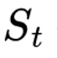
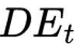
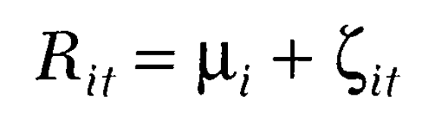
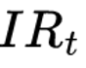
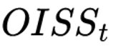
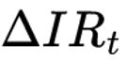
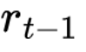
General Approach
Event study setup
How do Stocks react to Fed Sentiment?
Analysis of Abnormal Returns
Model Specification
How do we define abnormal returns
Constant Mean Return Model
(MacKinlay, 1997)
What Variables do we use
:
Sentiment Score
:
Debt/Equity Ratio
:
Fed Funds Rate
:
OIS Spread (Fear Gauge)
:
Change in IR (Surprise)
:
Lagged Returns
Calculate Abnormal returns for t+1 and regress:

Slide 6
What was our idea?
Initial event study setup
How do Stocks react to Fed Sentiment?
Data Used
Model Variation
Last 10 years (80 datapoints) : 2013-2023
S&P 500: Bloomberg
FOMC Meeting Minutes: FRED
Interest Rates : Bloomberg
(OISS: tbd) Interest rate surprises: Bloomberg
Lagged returns: Bloomberg
What Variables do we use
:
Sentiment Score
VADER
What Dimension of Sentiment is used? What kind of Sentiment analysis Approach is used (for the Tone) ?
VS
FinBERT

Slide 7
Does sentiment impact abnormal returns?
Approaches and methodology
How were the variables and Models Constructed?
The other variables are self-explanatory (for the most part – but how was the “Surprise” variable Constructed?
Difference between Federal Funds rate on announcement day and Fed Funds Futures as a gaugue for market expectations
Model I
(
(
Model II – Does Debt Matter?
(
(
Notes:
AR_{t+1} = \alpha + \beta_1 S_t + \beta_2 IR_t + \beta_3 \Delta IR_t + \beta_4 DE_t + \beta_5 OISS_t + \beta_6 r_{t-1} +\beta_7 \Delta IR_t*DE_t + \beta_8 S_t * DE_t

Slide 8
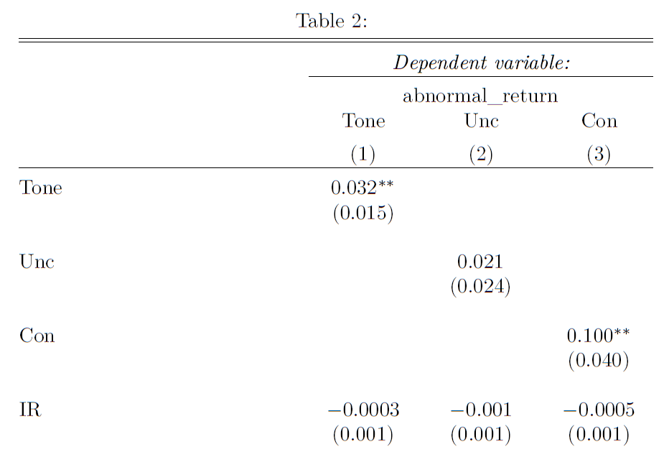
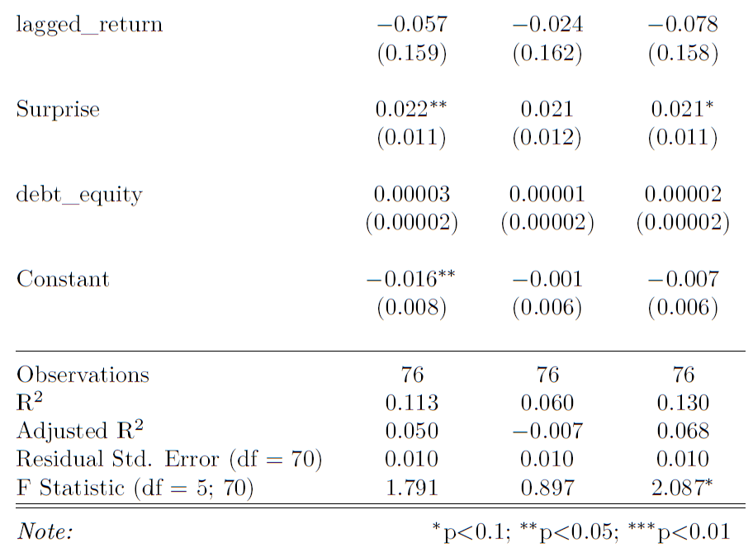
Our preliminary Results (1)

Slide 9
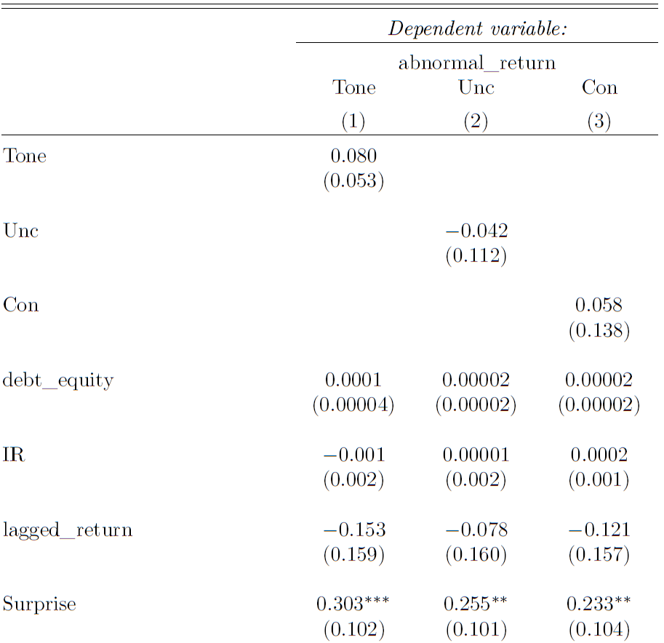
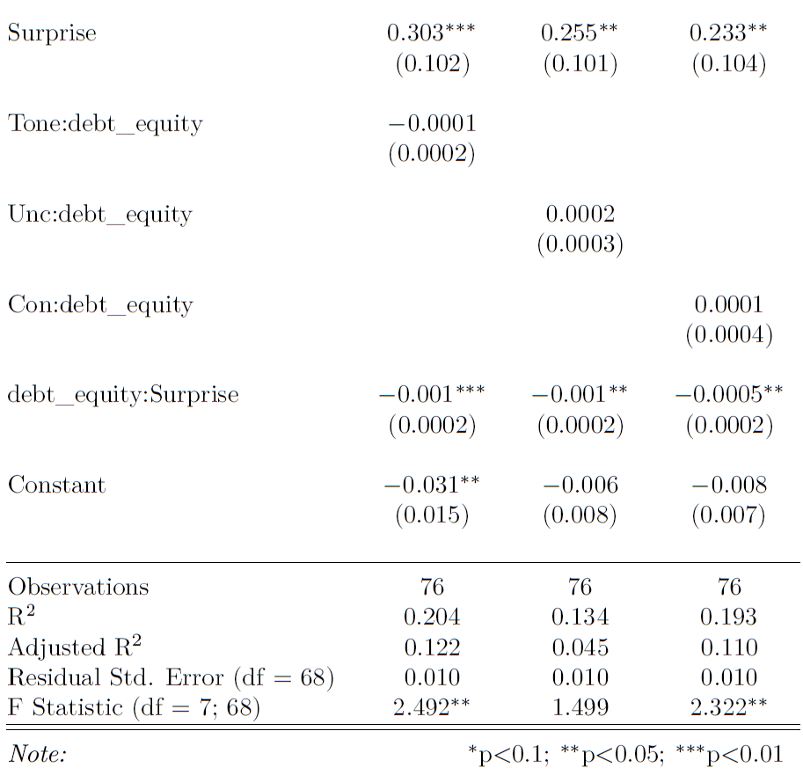
Our preliminary Results (2)

Slide 10
Next steps in the Analysis
Reevaluate the efficacy of the “Surprise” variable
FinBERT Sentiment “Tone” sentiment computation and model juxtaposition
OISS gaugue inclusion, with caveat of limited data
(potential) expansion of timeframe

Slide 12
Project Proposal & Paper Presentation
By Moeller and Reichmann (2021)
Matthias Fahrngruber
Filip Lukijanovic
Peter Prlleshi
December 21, 2023

Slide 13
Agenda
1
General idea of our project
2
Methodolgy of our paper
3
Results of our paper
4
Rebuilding the Linguistic Model
5
Our twist and our goals

Slide 14
What are we trying to achieve & what is our basis?
Are there immediate, abnormal returns on the stock market, specifically the S&P 500, because of FED communication?
Moeller and Reichmann (2019)
Easy to grasp approach → we can build upon it
Analysing sentiment through three channels:
General tone
Uncertainty
Constraint
1
2
3
4
5

Slide 15
What are we trying to achieve & what is our basis?
Are there immediate, abnormal returns on the stock market, specifically the S&P 500, because of FED communication?
Moeller and Reichmann (2019)
Easy to grasp approach → we can build upon it
Analysing sentiment through three channels:
General tone
Uncertainty
Constraint
1
2
3
4
5

Slide 16
What is Sentiment and why is it important?
“Sentiment can be described as the feeling a certain thought, opinion or idea is based on”
Words are not just words
More positive sentiment in ECB communication → higher equity market returns
Market participant pick up any possible cue by a central bank in order to predict future action of a central bank→ need to go deeper
1
2
3
4
5
Notes:
Sentiment give s a new level of complexity which we need to consider when analysing statements. The combination of words and the manner in which they are said is just as important, if not more.

Slide 17
How do they approach sentiment measurement?
Dictionary-based
Relies on pre-defined word-lists
Whole text is scanned for these words and a score is assigned
Does not account for grammatical or syntactical cues
Dictionary-based sentiment-mining
Also relies on word-lists (LM (2011)) incorporating financial communication
VADER-method → identify heuristics to determine sentiment intensity:
Intensifiers (e.g.: the results are very bad)
Contrastive conjunctions (e.g.: the preparation was good, but the result is bad)
Negations (e.g.: this was not a bad decision at all)
1
2
3
4
5
Notes:
The word lists have pre-defined sentiments (+, -, constraining, uncertain)
Cues can modify sentiment intensity and by missing on the cues, more complex sentences can be misunderstood by the algorithm → language is complex and we need to account for that
Decided against definig own dictionary because this way they can control the results
VADER was made for social media posts but it is also applicable here. Through vader generalizable heuristics can be identified and sentiment intensity of a text can be determined → complexity of human language is accounted while also using pre-defined word lists
Intensifiers: make a statement stronger
Contrastive conjunctions: shift the sentiment polarity of a sentence by conveying the sentiment after the conjunction
Negations: flip the polarity of a text → negative worded sentence is positive

Slide 18
VADER-Method
Words are being assigned a value:
+1 for positive
-1 for negative
Adjust VADER model for longer texts
Break text (i) into sentences (s)
Assign sentiment score to each s (ranging from -4 to +4)
Weight scores according to length
Uncertain (approximante, depend,…) and Constraining (comply, limit,…) statements
Uncertain statements (285 words) lead to eventual market movement
Constraining words (184 words) reduce uncertainty and impact market prices
1
2
3
4
5
Notes:
VADER model was made for short social media posts, needs to be adjusted for longer text by breaking a text I into its sentences s and assigning a sentiment score to each s. We then weight the sentence lengths after stopword removal → longer sentence usually carry more weight.
If unc score is high → indication of imprecision by ECB presidents → market movement
If Cons score is high → ECB is constrained by current line or course → reduce uncertainties about future ECB decisions and impact market prices

Slide 19
Results
Baseline Regression of intraday returns of STOXX50 and SX7E on text mining variables
Variable Tone has a significant positive impact on both indices
i.e. positive (negative) language is associated with higher (lower intraday returns)
Especially for SX7E index which is a bank index and banks base their models on interest rate expectations
Variable Unc, Con and Pre are not significant in the whole model
Unc and Con are significant when regressed by them self with SX7E
Forward Guidance (ForGui) is significant
Based on the results of forward guidance authors then changed their regression based on the macroeconomic environment
i.e. Pre-Crisis Period (2002-2007), Crisis Period (2008-2013) and Quantitative Easing Period (2013 – 2019)
1
2
3
4
5

Slide 20
Results
Regression based on macroeconomic environment
Variable Tone still significant with every period discussed earlier and again with stronger impact on the SX7E
Variable Con has a positive significant impact on returns in the QE period
Again, with SX7E having bigger market reactions then Stoxx50’s
Constraining sentiments are especially useful for central banks to express policy commitment
Separate n-gramm analysis was conducted which concluded that words such as mandate, commitment and unanimous are the drivers of Constraining sentiments
The results suggest that, overall, market participants value the communication of a strong commitment during periods of the zero lower bound. This is because it helps reduce uncertainties regarding the future direction of the ECB's monetary policy decisions.
1
2
3
4
5

Slide 21
Results
Regression based on monetary analysis and economic analysis
As a third step they split the central bank speeches into monetary analysis segment and economic analysis segment
The monetary analysis segment has again a positive significant impact in constraining language in the QE period
Also, uncertain language in the crisis period has a significant negative impact on stock returns. This is contrary to effects on economc analysis using uncertain language where the effect is positive.
Projections of economic and financial risks can impact stock returns in two ways.
They may induce information shocks, potentially decreasing stock returns,
Central bank communications addressing such risks may be interpreted by market participants as signals of forthcoming expansive monetary policy decisions, influencing the macroeconomic environment and affecting stock returns.
1
2
3
4
5

Slide 22
Results
Q&A’s
As Q&A’s are no longer scripted, the authors also regressed the Q&A part of central bank speeches, as they may disclose further informations relevant for capital markets.
The only significant variable is tone in crisis times, which indicates that the language used in the Q&A sessions is of less importance for capital markets compared to the introductory statements.
Can be possibly be due to reporters asking current or backward looking questions, whereas capital markets are usually forward looking.
Because of this the authors also analysed forward looking specific answers from the Q&A’s
Forward looking statements that bear positive (negative) sentiment are associated with increasing (decreasing) intraday stock returns during times of financial crises.
uncertainty sentiment is also associated with increasing intraday returns during the pre-crisis period and the constraining sentiment to be also associated with increasing intraday returns during the QE-period.
1
2
3
4
5

Slide 23
Conclusion
ECB officials use constraining sentiment to state policy commitment. This has a significant positive effect on intraday stock returns of the STOXX50 and the SX7E in times of unconventional monetary policy.
The language used by ECB officials in their economic outlook has a significant effect on intraday returns of the STOXX50 and the SX7E. The authors find that uncertainty sentiment has a significant positive effect on intraday returns prior to the global financial crisis.
The overall tone of ECB press conferences also has a significant positive effect on intraday stock returns during times of economic uncertainty.
By focusing on forward-looking statements within answers by ECB officials during Q&A sessions in ECB press conferences this paper shows that answers can significantly influence intraday returns
1
2
3
4
5

Slide 24
All the Sentiments…
Methodology of Sentiment Analysis
Sentiment is measured across 3 Dimensions
Tone
Constraining Language
Uncertain Language
Simple approach to sentiment with a financial twist
Sentiments are reoriented in their goal “function”
Question: How will markets react to uncertainty?
Heuristics-adjusted means the whole lexicon needs to be reoriented in its constituents‘ ratings
VADER takes on values from -4 to 4, respectively, to account for intensity – we include our „Uncertain“ words with an intensity of 2 into the VADER lexicon
Our Approach
Reformulating Lexicon is infeasible → weigh the heuristic factors down and expand lexicon by Constraining words
Expansion of Lexicon with terms in Finance as proposed by
“perhaps”
“could”
“would”
“certain”
1
2
3
4
5

Slide 25
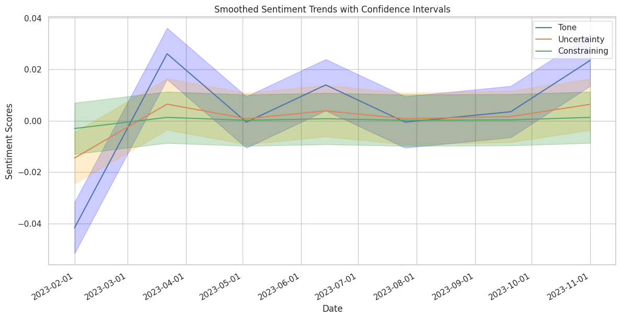
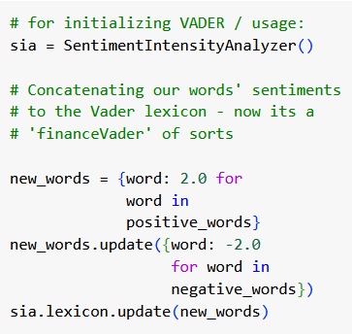
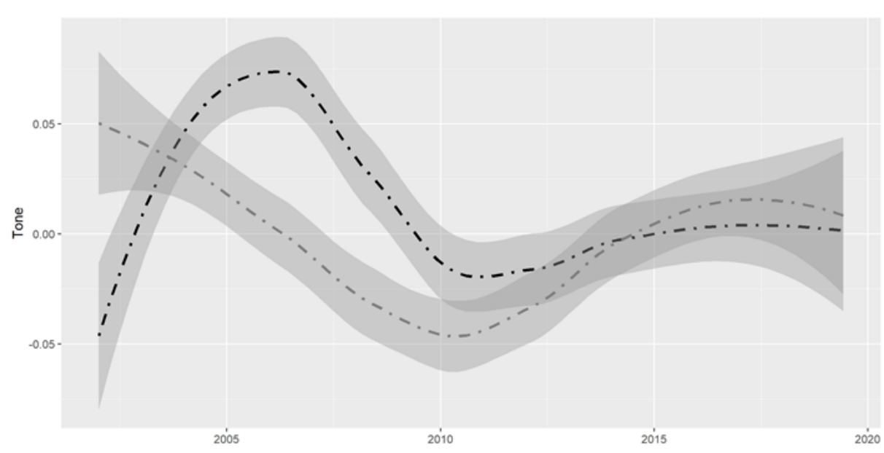
All the Sentiments…
3 Sentiment Channels
IR
1
2
3
4
5

Slide 26
General Approach
Event study setup
How do Stocks react to Fed Sentiment?
Analysis of Abnormal Returns
Model Specification
How do we define abnormal returns
Constant Mean Return Model
(MacKinlay, 1997)
What Variables do we use
:
Sentiment Score
:
Debt/Equity Ratio
:
Fed Funds Rate
:
OIS Spread (Fear Gauge)
:
Change in IR (Surprise)
:
Lagged Returns
Calculate Abnormal returns for t+1 and regress:
1
2
3
4
5

Slide 27
What was our idea?
Initial event study setup
How do Stocks react to Fed Sentiment?
Data Used
Model Variation
Last 10 years (80 datapoints) : 2013-2023
S&P 500: Bloomberg
FOMC Meeting Minutes: FRED
Interest Rates : Bloomberg
(OISS: tbd) Interest rate surprises: Bloomberg
Lagged returns: Bloomberg
What Variables do we use
:
Sentiment Score
VADER
What Dimension of Sentiment is used? What kind of Sentiment analysis Approach is used (for the Tone) ?
VS
FinBERT
1
2
3
4
5

Slide 28
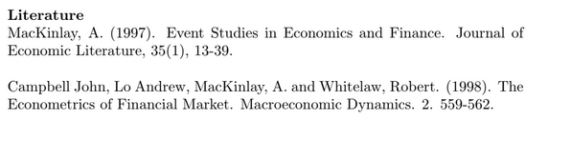
Rough outline:
Key pointers in paper
Dictionary approach via VADER
Sentiments on Tone, Constrainedness, Uncertainty etc.
Further controls for estimating reactions
PCA Usage to capture surprises – Timing, ForGui, and QuantE
Cool addition from our side – we recreated a bit of their plots of sentiment components as well (and we can talk a bit about that as well)
Our Approach
Event Study design of Abnormal returns on T+1 (and maybe T+3 but way more work) after announcements
Abnormal returns via constant mean return model, as in MacKinlay (1997)
Inclusion of Sentiment Tone into our regression, and inspection of result changes with inclusion of Unc and Con
To be discussed: FinBERT use as well, to see which model predicts the Tone better??

Slide 29
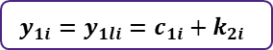
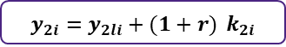
What is our twist?
Event study setup
How do Stocks react to Fed Sentiment?
Analysis of Abnormal Returns
Recent theory
Stiglitz & Atkinson (1976) conclude Γ=0
Assumptions
Can capital income and labour income be substituted easily?
Fuzzy Boundary
2-Period Life
No Inheritance
Labor income
Among business owners, it is relatively more easy to shift between labor and capital income, i.e. by deciding on the payout of wages to the CEO – Employee stock options apply here too
t₁ :
$$y_{1i}=y_{1li}=c_{1i}+k_{2i}$$
t₂ :
$y_{2i}=y_{2li}+(1+r)$ $k_{2i}$
Given this “fuzziness“ assumption, governments have difficulty discerning income flows and may rather tax incomes with minimal tax differences – this difference hinges on 2 elasticities‘ sizes
The authors conclude that a capital income tax only leads to intertemporal distortions, leading to a tax exclusively on income
$ε$(intertemporal distortion) vs $ε$(income shifting)
1
2
3
4
5
6
7

Slide 30




How has Inequality Theory Evolved?
Research Rationale
Theory is tested against practice driven by the spike in recent Inequality
Theory
Practice
Has theory moved on from “old” models suggesting no wealth tax?
Inequality dynamics and taxes – have they moved in opposite directions?
Lower Taxes
Higher Inequality
+
Meritocratic argument for inheritance taxes
Prior models advocated for zero capital income tax
Recent models provide scope for capital taxation
The advent of Reaganomics gave rise to a plethora of corporate & private tax cuts
Inequality is slowly approaching record levels of the early 20th century
1
2
3
4
5
6
7

Slide 31
Comprehensive Income Tax
Rationale: What is Capital income, What is Labor Income → Fuzzy Boundary
Considerations:
What is the theoretical case for separate taxation?
“Old” Stiglitz and Atkinson → most efficient to tax income
Separate taxation should be very close if income shifting elasticity high
Consumption Tax? We discussed this – very very tough to implement, especially via discounted lifetime consumption, or annual consumption (verbally: consumption tax also doesn’t match the other models, i.e. the “old” one in terms of optimal labor tax and efficiency)
In the (preliminary) end: Elasticity of cross sectional income shifting vs. of intertemporal substitution (consumption) → show that tax gap l&k inverse to elasticity
Tax Corporate income like labor income?
Notes:
Action Title – Comp inc & title: What if we just tax everything as Income?

Slide 32
Should all income be taxed the same?
Capital vs. Labor Income : Fuzzy Boundary
Recent Models Deviate from 0 Capital Income Tax
Classic Theory
Recent theory
Stiglitz & Atkinson (1976) conclude Γ=0
Assumptions
Can capital income and labour income be substituted easily?
Fuzzy Boundary
2-Period Life
No Inheritance
Labor income
Among business owners, it is relatively more easy to shift between labor and capital income, i.e. by deciding on the payout of wages to the CEO – Employee stock options apply here too
t₁ :
$$y_{1i}=y_{1li}=c_{1i}+k_{2i}$$
t₂ :
$y_{2i}=y_{2li}+(1+r)$ $k_{2i}$
Given this “fuzziness“ assumption, governments have difficulty discerning income flows and may rather tax incomes with minimal tax differences – this difference hinges on 2 elasticities‘ sizes
The authors conclude that a capital income tax only leads to intertemporal distortions, leading to a tax exclusively on income
$ε$(intertemporal distortion) vs $ε$(income shifting)
1
2
3
4
5
6
7

Slide 33
Progressive Wealth Tax
What’s easier, finding the wasp or the nest? (WILL be deleted lol)
Flows much harder to trace and time-sensitive than stocks (wealth)
Only small proportion of returns paid out as income (ANECDOTAL evidence – whatever that means, as verbal crutch)
What if only wealth can be observed? (merge with first bullet):
Model of capital model of taxation (1+r)xK → Y?→ visible, and transparent (stock)
Returns mostly asset prices, not flows (DCF) – consumption small in comparison for top pc. Unreal. Gains T hard 2 implement
How about efficiency? – 2 models – show em both and argue for the entrepreneur friendly one → you make returns and risk→ reward, u a leech? Bad day for u :/
The ONLY tool to date to capture some form of unrealized gains ☺
Ok so efficiency considerations: in a dynastic society, lot of effect of the tax, entrepreneurial, not so much
Tax rate also dep on elasticity – if I tax, will everyone run away? Seems 2 b 10 %, quickmath of T1 30%W (W/Y at 5), then 1.5% of nat income raised yrly!
Notes:
Action Title – Comp inc & title: What if we just tax everything as Income?

Slide 34



How easily can flows be observed
Rationale for a Progressive Wealth Tax
General Logic
Solution – 2 Proposals
The authors argue for a wealth tax of 6-8% to tackle inequality
Taxing Returns
Taxing Wealth
Flows much harder to trace and time-sensitive than stocks/wealth
t+1 :
$${Γ(∆k}_{ti})$$
t+1 :
$${Γ((1+R)k}_{ti})$$
Taxing unrealized gains can be very difficult for two reasons:
Taxing wealth as depicted hits highly productive entrepreneurs and less productive heirs in a differentiated matter
Only small proportion of returns paid out as income – unrealized income very hard to capture!
Volatility of asset prices
Wealth easier to be observed as its size is not as time-dependent
Power: Wealth Stock, not Flow
Taxes affect the distribution through transfers as well as through a dampening effect on the effort by capital owners to produce high returns
Taxing returns hurts more productive entrepreneurs than dynastic heirs
1
1
2
2
3
3
4
4
5
5
6
7

Slide 35
How easily can flows be observed
Rationale for a Progressive Wealth Tax
General Logic
Solution – 2 Proposals
The authors argue for a wealth tax of 6-8% to tackle inequality
Taxing Returns
Taxing Wealth
Flows much harder to trace and time-sensitive than stocks/wealth
t+1 :
$${Γ(∆k}_{ti})$$
t+1 :
$${Γ((1+R)k}_{ti})$$
Taxing unrealized gains can be very difficult for two reasons:
Less effect of taxes on distribution in entrepreneurial societies than dynastic ones
Only small proportion of returns paid out as income – unrealized income very hard to capture!
Volatility of asset prices
Wealth easier to be observed as its size is not as time-dependent
Power: Wealth Stock, not Flow
High Tax revenue potential given ß=5:
“if the top 1% owns 30% of wealth, a 1% average wealth tax on the top 1% raises about 5 x 0.3 x 1% = 1.5%
of national income”
Taxing returns hurts more productive entrepreneurs than dynastic heirs
1
2
3
4
5
6
7

Slide 36

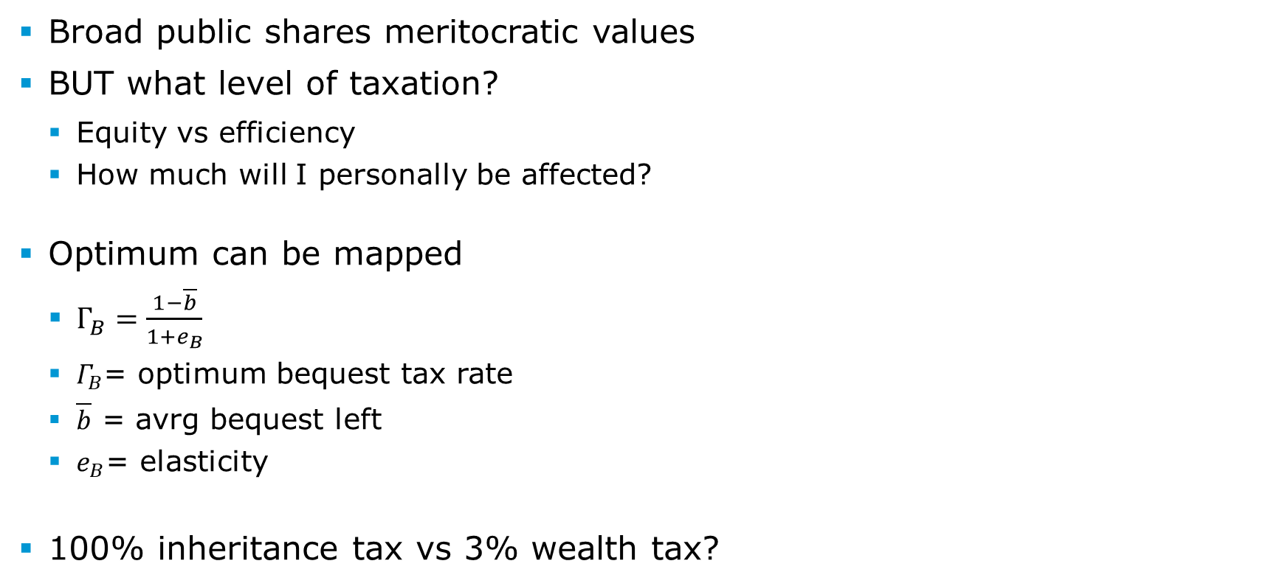
Progressive Inheritance Tax
Anm.: Ch.4
Broad public shares meritocratic values
BUT what level of taxation?
Equity vs efficiency
How much will I personally be affected?
Optimum can be mapped
$Γ_{B}=\frac{1−\overline{b}}{1+e_{B}}$
$Γ_{B}$= optimum bequest tax rate
$\overline{b}$ = avrg bequest left
$e_{B}$= elasticity
100% inheritance tax vs 3% wealth tax?
 | I will inherit | I will not inherit
I will bequest
I will not bequest
?
?

Slide 37


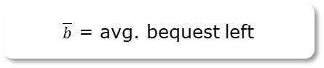
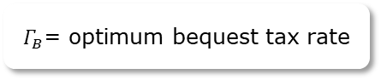
Progressive Inheritance Tax
Rationale for an Inheritance Tax
The Public Shares Meritocratic Values
100% inheritance tax vs 3% wealth tax?
BUT what level of Taxation?
 | I will inherit | I will not inherit
I will bequest
I will not bequest
Equity vs. Efficiency
How much will I personally be affected?
?
Optimum can be mapped
$$Γ_{B}=\frac{1−\overline{b}}{1+e_{B}}$$
$Γ_{B}$= optimum bequest tax rate
?
$\overline{b}$ = avg. bequest left
$$e_{B}\text{= }\text{elasticity}$$
1
2
3
4
5
6
7

Slide 38
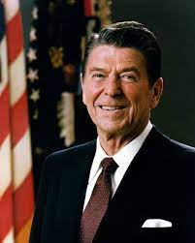
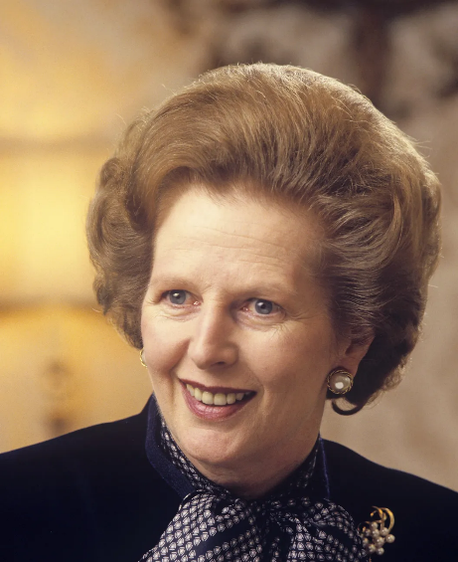
A Brief History of Taxes
Anm.: Ch.5.1-5.2
1890 - 1910
Comprehensive income tax in developed countries
+ corporate income tax
Objective: equity across sources and across income levels
1910 – 1980
Steeply progressive inheritance taxes
Challenges for capital gain taxes
Objective: decrease inter-generational wealth disparities
1980 - today
Reagan & Thatcher → declining tax progressivity
More regressivity in Europe than US

Slide 39
A Brief History of Taxes
1890 - 1910
Comprehensive income tax in developed countries
+ corporate income tax
Objective: equity across sources and across income levels
1910 - 1980
Steeply progressive inheritance taxes
Challenges for capital gain taxes
Objective: decrease inter-generational wealth disparities
1980 - Today
Reagan & Thatcher → declining tax progressivity
More regressivity in Europe than US
1
2
3
4
5
6
7

Slide 40
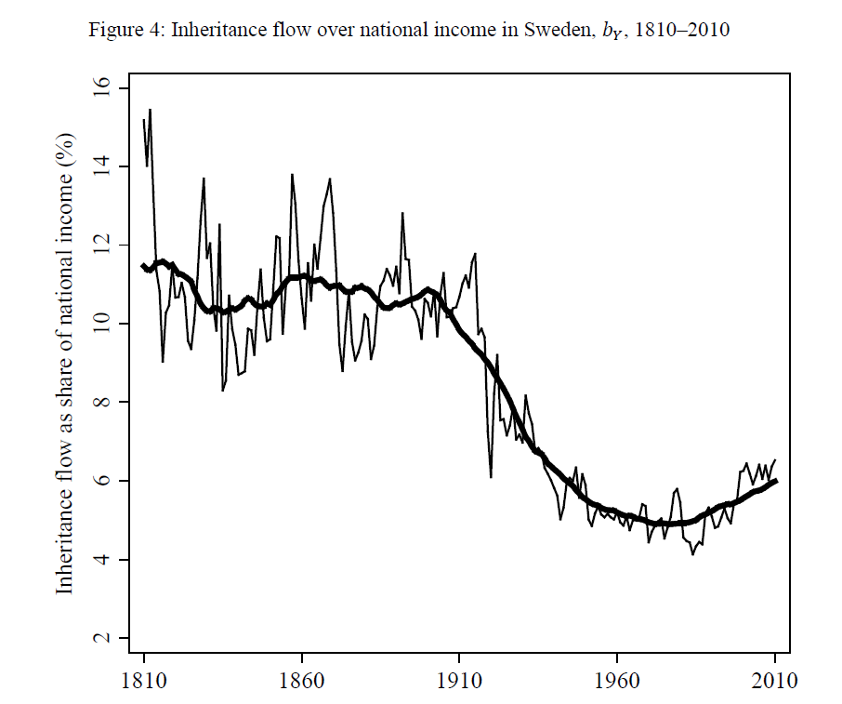
The Problems of Taxation
Anm.: Ch.5.2
Regressivity
Consumption taxes
Income tax (tax havens & legal loopholes)
Income tax (political decision)
Politics:
Decline in inherited wealth?
Decline in wealth inequality?
Change in balance of political power
Financial globalisation
Source: World Inequality Database. “Top 10% net personal wealth share" (2023)
Source: Ohlsson, Henry, Jesper Roine, and Daniel Waldenström. "Inherited wealth over the path of development: Sweden, 1810–2010." (2014)

Slide 41
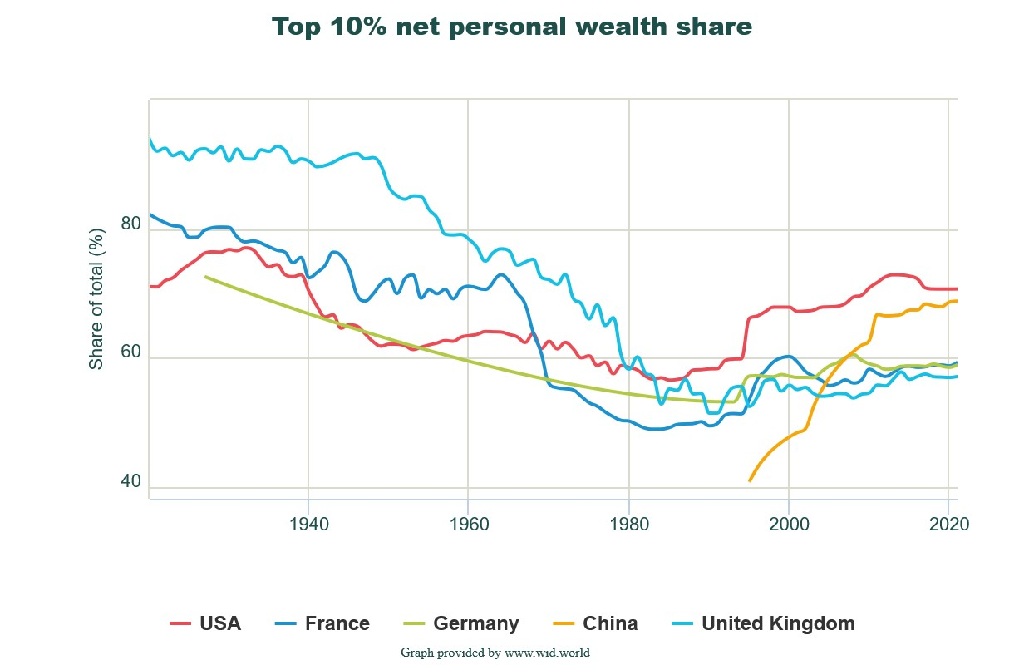
How Can We Get to a Better Place?
The Problems of Taxation
Regressivity
- Consumption taxes
- Income tax (tax havens & legal loopholes)
- Income tax (political decision)
Politics
- Decline in inherited wealth?
- Decline in wealth inequality?
- Change in balance of political power
- Financial globalization
Source: World Inequality Database. “Top 10% net personal wealth share" (2023)
Source: Ohlsson, Henry, Jesper Roine, and Daniel Waldenström. "Inherited wealth over the path of development: Sweden, 1810–2010." (2014)
1
2
3
4
5
6
7
Consumer surveys

Slide 42
What is the Way Forward?
The Future of Taxes
Tax Havens → more international tax coordination?
Promising agreements, yet hardly any implementation
Increasing wealth taxes (with flaws)
Purposes of taxation:
Raise revenue
Redistribution of wealth
Propose a minimum universal inheritance
Amounting at least 60% of average wealth at age 25
Cost: 5% of national income
Effects on other economic aspects?
1
2
3
4
5
6
7
Consumer surveys

